Slide 1
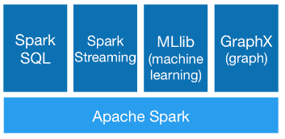

Slide 2
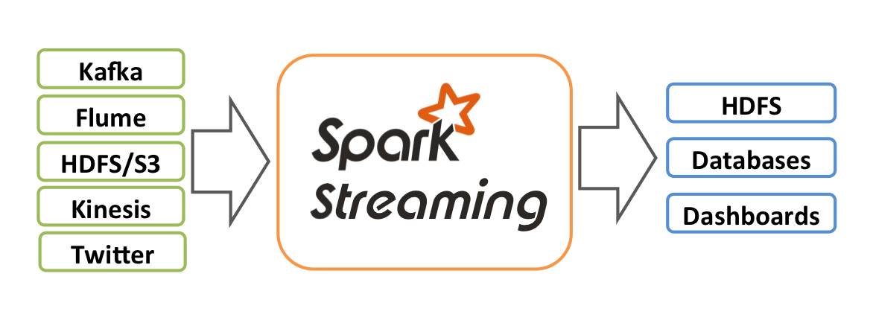
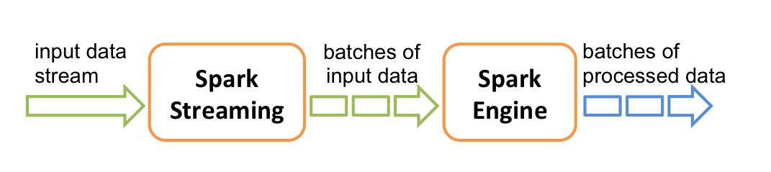
Spark Streaming
Supports real time processing of streaming data
Using the Spark core for parallelization & fault tolerance
Combine streaming with batch and interactive queries.
Example: Standalone: http://www.cse.ust.hk/msbd5003/network_wordcount.py
Notebook (shell): http://www.cse.ust.hk/msbd5003/nb/stream.ipynb

Slide 3
Steps of a Spark Streaming application
Define the input sources by creating input DStreams.
Define the streaming computations by applying transformation and output operations to DStreams.
Start receiving data and processing it using streamingContext.start().
Wait for the processing to be stopped (manually or due to any error) using streamingContext.awaitTermination().
The processing can be manually stopped using streamingContext.stop().

Slide 4
Points to note
Once a context has been started, no new streaming computations can be set up or added to it.
Once a context has been stopped, it cannot be restarted.
Only one StreamingContext can be active in a JVM at the same time.
stop() on StreamingContext also stops the SparkContext. To stop only the StreamingContext, set the optional parameter of stop() called stopSparkContext to false.
A SparkContext can be re-used to create multiple StreamingContexts, as long as the previous StreamingContext is stopped (without stopping the SparkContext) before the next StreamingContext is created.
Interrupting the streaming program in the shell / jupyter cannot properly clean up the streaming tasks (even after running ssc.stop). You will have to shut down the kernel and re-open the notebook.

Slide 5
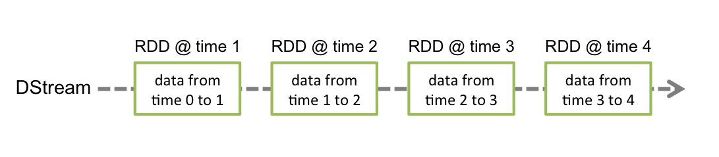
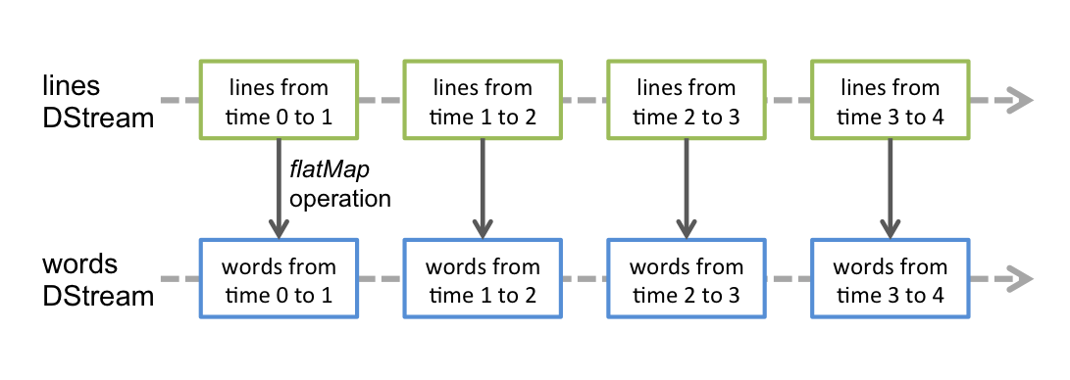
Discretized Streams (DStreams)
DStream: a continuous stream of data.
DStreams can be created
from input data streams
by applying high-level operations on other DStreams.
Internally, a DStream is represented as a sequence of RDDs.
Any operation applied on a DStream translates to operations on the underlying RDDs.

Slide 6
Input DStreams and Receivers
Input DStreams are DStreams representing the stream of input data received from streaming sources.
Every input DStream is associated with a Receiver
Note: Each Receiver requires a core, so you need to allocate more cores than the number of input Dstreams.
Two categories of built-in streaming sources:
Basic sources: Sources directly available in the StreamingContext API. Examples: file systems, socket connections, rdd queues.
Advanced sources: Other streaming systems like Kafka, Flume, Kinesis, etc.

Slide 7
Transformations on DStreams
DStreams support many of the transformations available on normal Spark RDD’s. See online manual for details.
transform(): Invoke any RDD operation on a Dstream

Slide 8
UpdateStateByKey
Allows you to maintain arbitrary state while continuously updating it with new information
Steps:
Define the initial state: An RDD of (key, value) pairs
Define the state update function - Specify a function on how to update the value using the previous value and the new values from an input stream.
In every batch, Spark will apply the state update function for all existing keys, regardless of whether they have new data in a batch or not
If the update function returns None then the key-value pair will be eliminated.

Slide 9
Streaming Algorithms

Slide 10
Missing Card
I take one from a deck of 52 cards, and pass the rest to you. Suppose you only have a (very basic) calculator and bad memory, how can you find out which card is missing with just one pass over the 51 cards?
What if there are two missing cards?

Slide 11
A data stream algorithm …
Makes one pass over the input data
Uses a small amount of memory (much smaller than the input data)
Computes something

Slide 12
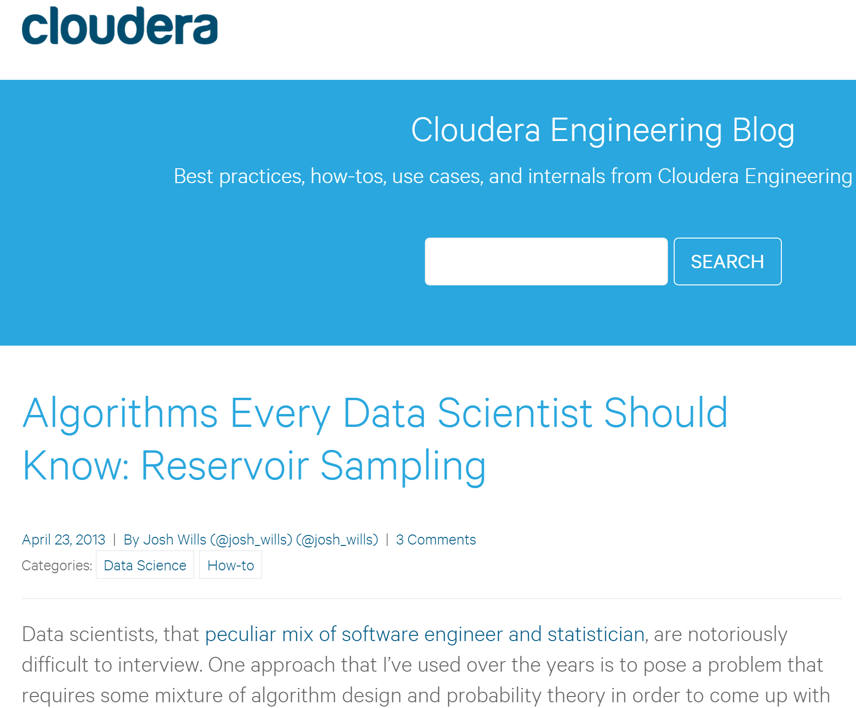

Slide 13
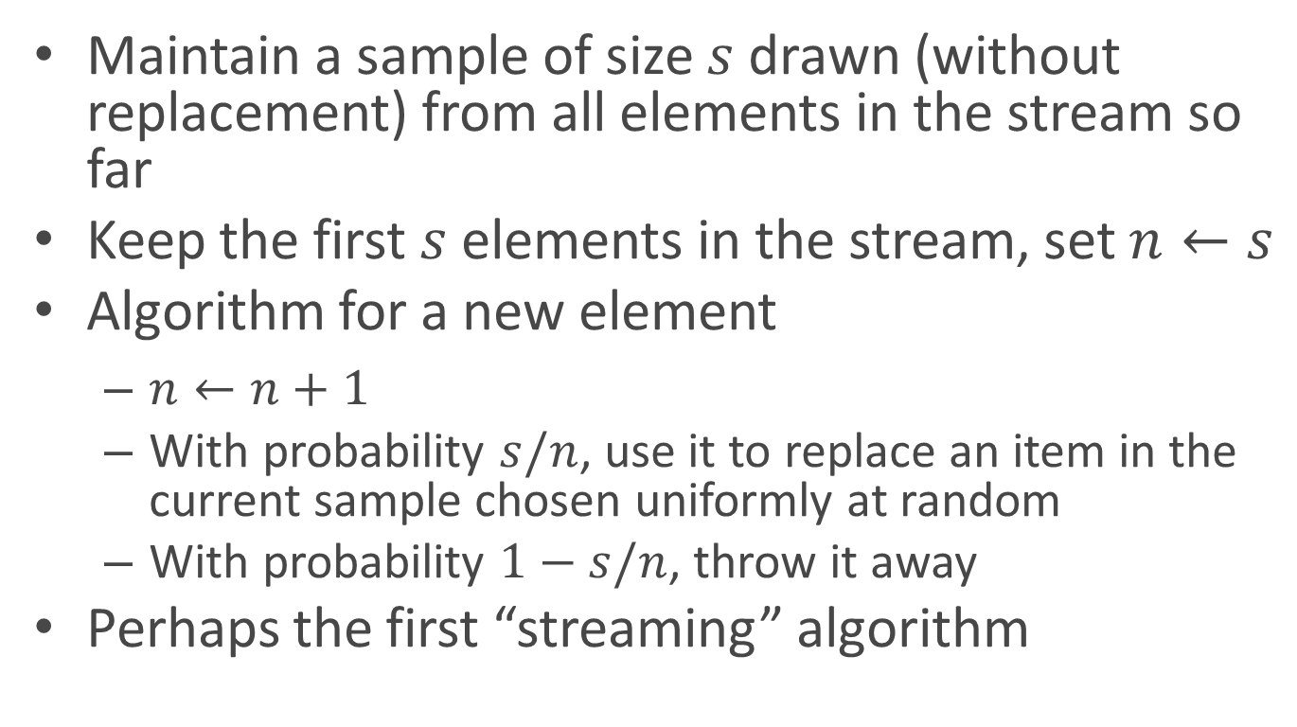
Reservoir Sampling
Maintain a sample of size $s$ drawn (without replacement) from all elements in the stream so far
Keep the first $s$ elements in the stream, set $n←s$
Algorithm for a new element
$n←n+1$
With probability $s/n$, use it to replace an item in the current sample chosen uniformly at random
With probability $1−s/n$, throw it away
Perhaps the first “streaming” algorithm
[Waterman ??; Knuth’s book]

Slide 14
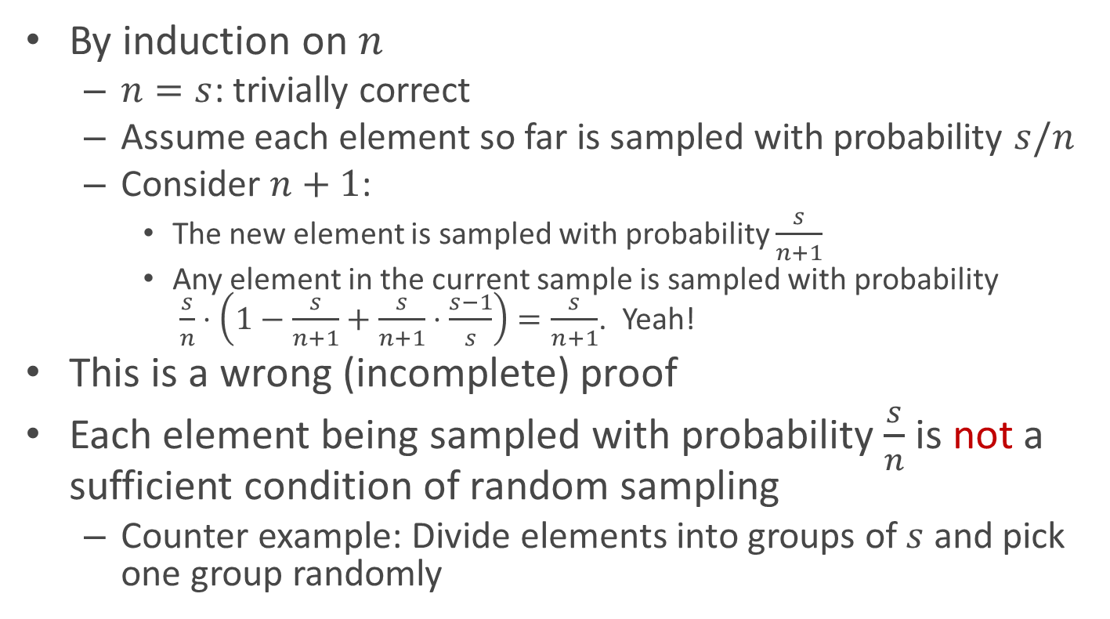
Correctness Proof
By induction on $n$
$n=s$: trivially correct
Assume each element so far is sampled with probability $s/n$
Consider $n+1$:
The new element is sampled with probability $\frac{s}{n+1}$
Any element in the current sample is sampled with probability $\frac{s}{n}⋅\left(1−\frac{s}{n+1}+\frac{s}{n+1}⋅\frac{s−1}{s}\right)=\frac{s}{n+1}$. Yeah!
This is a wrong (incomplete) proof
Each element being sampled with probability $\frac{s}{n}$ is not a sufficient condition of random sampling
Counter example: Divide elements into groups of $s$ and pick one group randomly

Slide 15
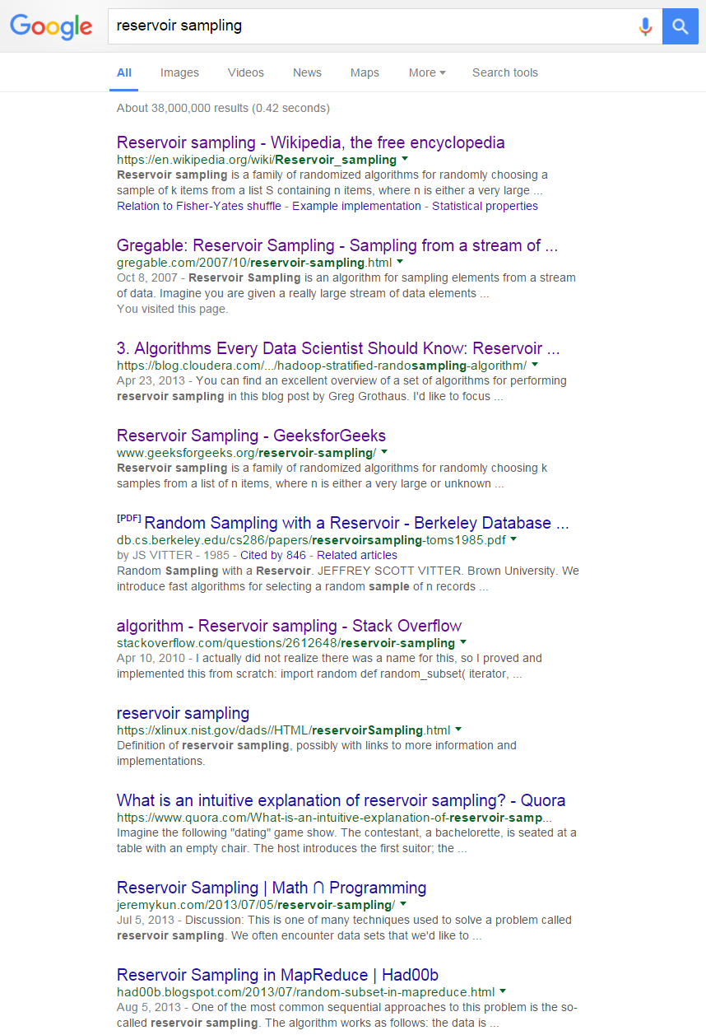


Slide 16
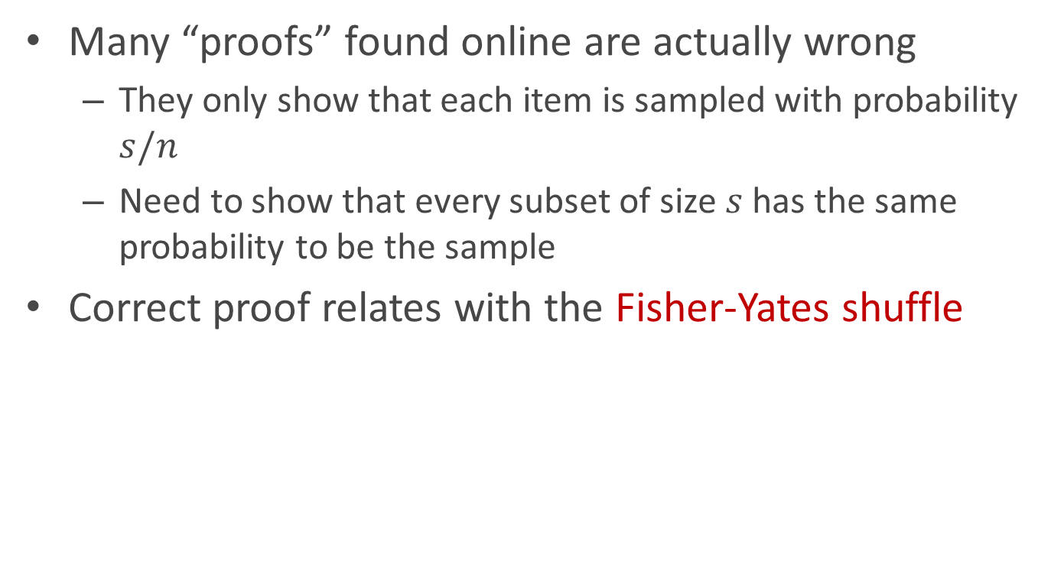
Reservoir Sampling Correctness Proof
Many “proofs” found online are actually wrong
They only show that each item is sampled with probability $s/n$
Need to show that every subset of size $s$ has the same probability to be the sample
Correct proof relates with the Fisher-Yates shuffle
s = 2
a
a
b
b
b
b
b
a
c
d
c
c
c
a
a
d
d
d
d
c

Slide 17
Majority
Given a sequence of items, find the majority if there is one
A A B C D B A A B B A A A A A A C C C D A B A A A
Answer: A
Trivial if we have O(n) memory
Can you do it with O(1) memory and two passes?
First pass: find the possible candidate
Second pass: compute its frequency and verify that it is > n/2
How about one pass?
Unfortunately, no

Slide 18
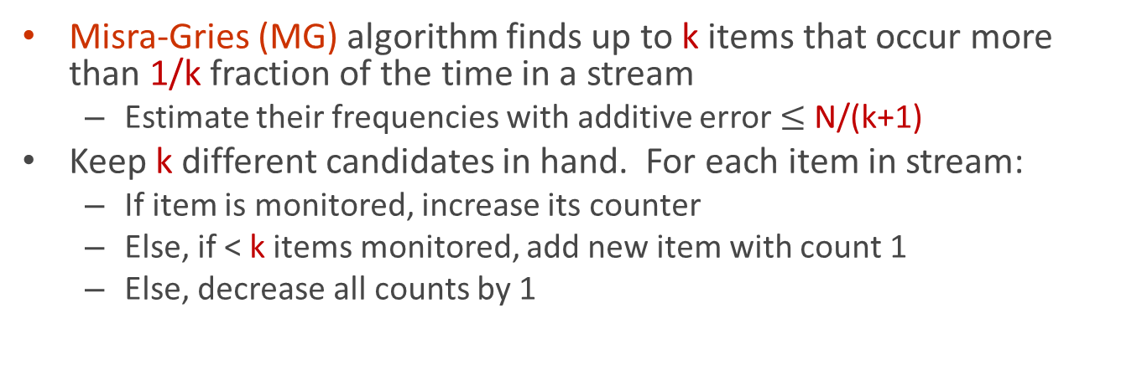
Heavy hitters
Misra-Gries (MG) algorithm finds up to k items that occur more than 1/k fraction of the time in a stream
Estimate their frequencies with additive error $≤$ N/(k+1)
Keep k different candidates in hand. For each item in stream:
If item is monitored, increase its counter
Else, if < k items monitored, add new item with count 1
Else, decrease all counts by 1
k=5
1 2 3 4 5 6 7 8 9

Slide 19
Heavy hitters
Misra-Gries (MG) algorithm finds up to k items that occur more than 1/k fraction of the time in a stream
Estimate their frequencies with additive error $≤$ N/(k+1)
Keep k different candidates in hand. For each item in stream:
If item is monitored, increase its counter
Else, if < k items monitored, add new item with count 1
Else, decrease all counts by 1
k=5
1 2 3 4 5 6 7 8 9

Slide 20

Heavy hitters
Misra-Gries (MG) algorithm finds up to k items that occur more than 1/k fraction of the time in a stream
Estimate their frequencies with additive error $≤$ N/(k+1)
Keep k different candidates in hand. For each item in stream:
If item is monitored, increase its counter
Else, if < k items monitored, add new item with count 1
Else, decrease all counts by 1
k=5
1 2 3 4 5 6 7 8 9

Slide 21
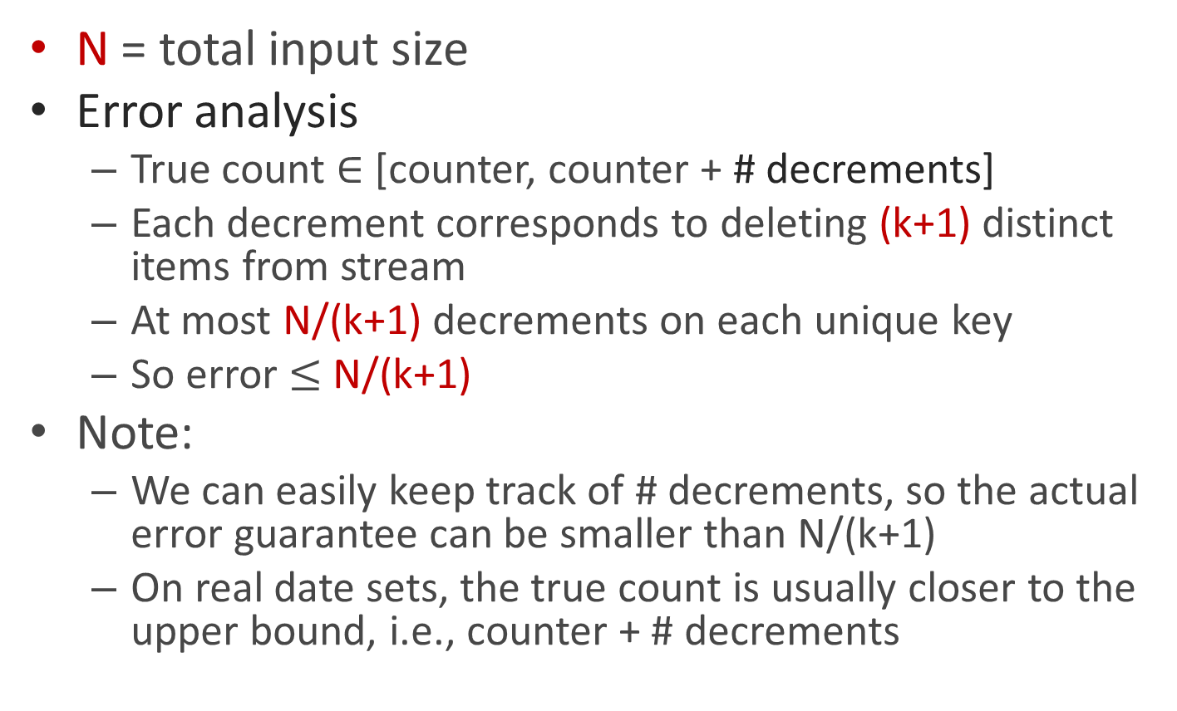
Streaming MG analysis
N = total input size
Error analysis
True count $∈$ [counter, counter + # decrements]
Each decrement corresponds to deleting (k+1) distinct items from stream
At most N/(k+1) decrements on each unique key
So error $≤$ N/(k+1)
Note:
We can easily keep track of # decrements, so the actual error guarantee can be smaller than N/(k+1)
On real date sets, the true count is usually closer to the upper bound, i.e., counter + # decrements

Slide 22
Implementing MG algorithm in SparkStreaming
The classical MG algorithm is sequential.
Need to turn it into a parallel algorithm.
Idea 1: The increment operation and decrement operations can be decoupled.
Idea 2: Both increment operations and decrement operations can be performed in batches.
We may exceed our space budget sometimes, but at most by a batch size.

Slide 23
Parallel MG Algorithm
All counters = 0
total_decrement = 0
threshold = 0
For each batch do
Count the words in this batch
For each item in the batch, do the following in parallel:
Add its count to the corresponding counter
Subtract threshold from the counter
If counter becomes 0 or negative, remove it
If # counters > k, threshold = the k-th largest counter, else threshold = 0
total_decrement += threshold
Final estimate = (counter, counter+total_decrement)

Slide 24
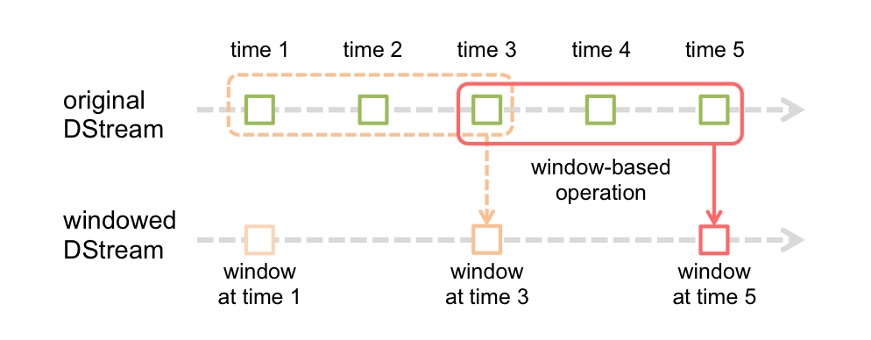
Sliding windows
Note:
The aggregation function must be associative and commutative so that it can be computed correctly in parallel.
Inverse function is optional but can improve efficiency
Question: For what aggregates do we not have an inverse function?

Slide 25
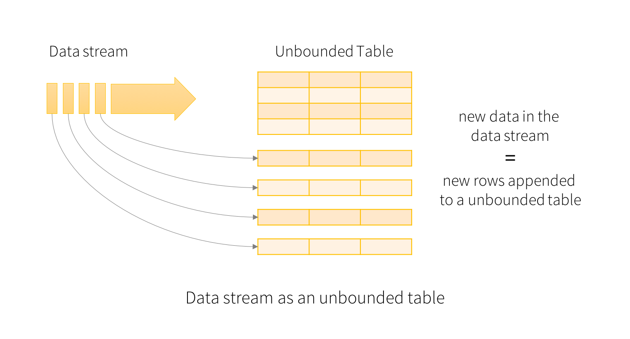
Structured Streaming (Alpha)
Structured streaming = Spark Streaming on top of Spark SQL

Slide 26
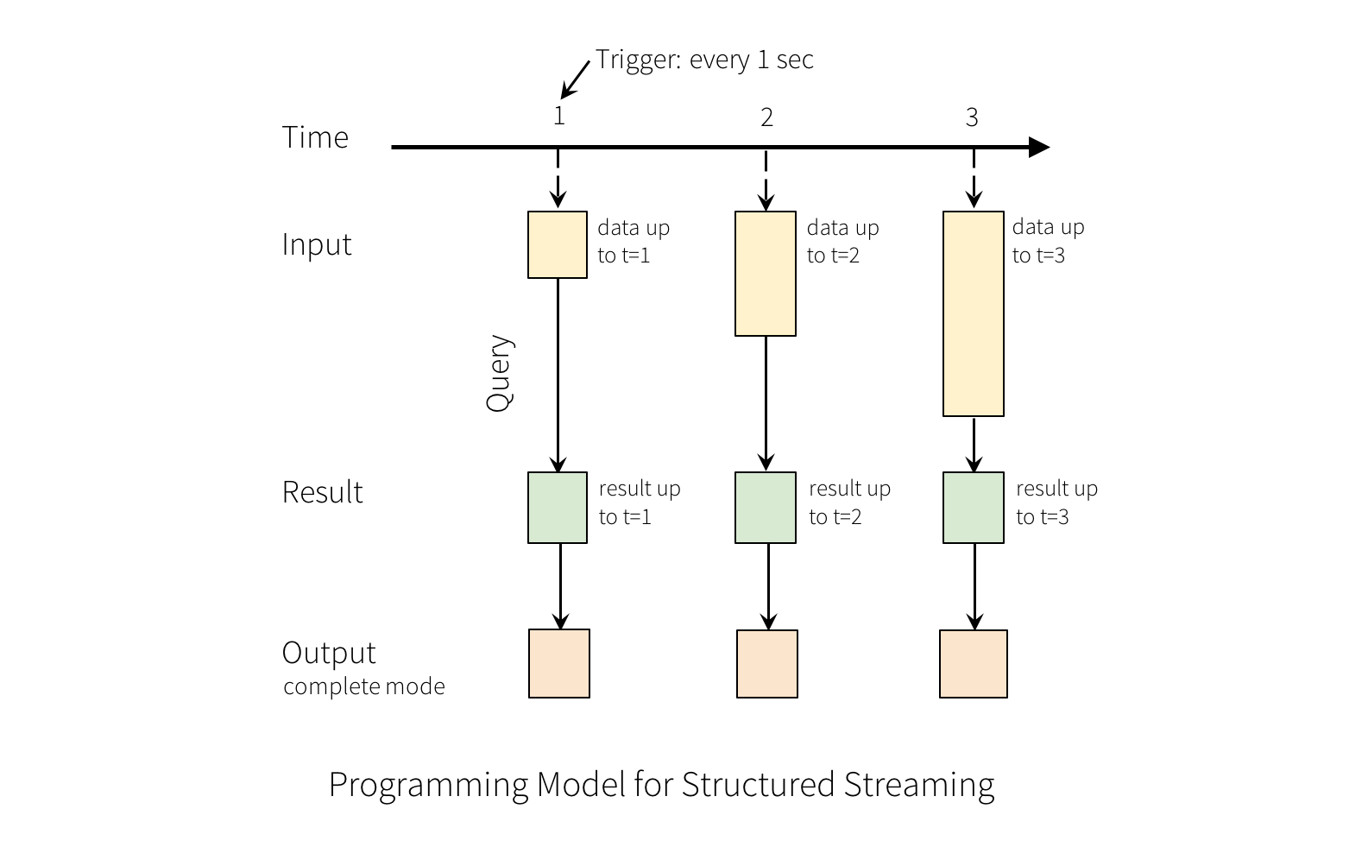

Slide 27
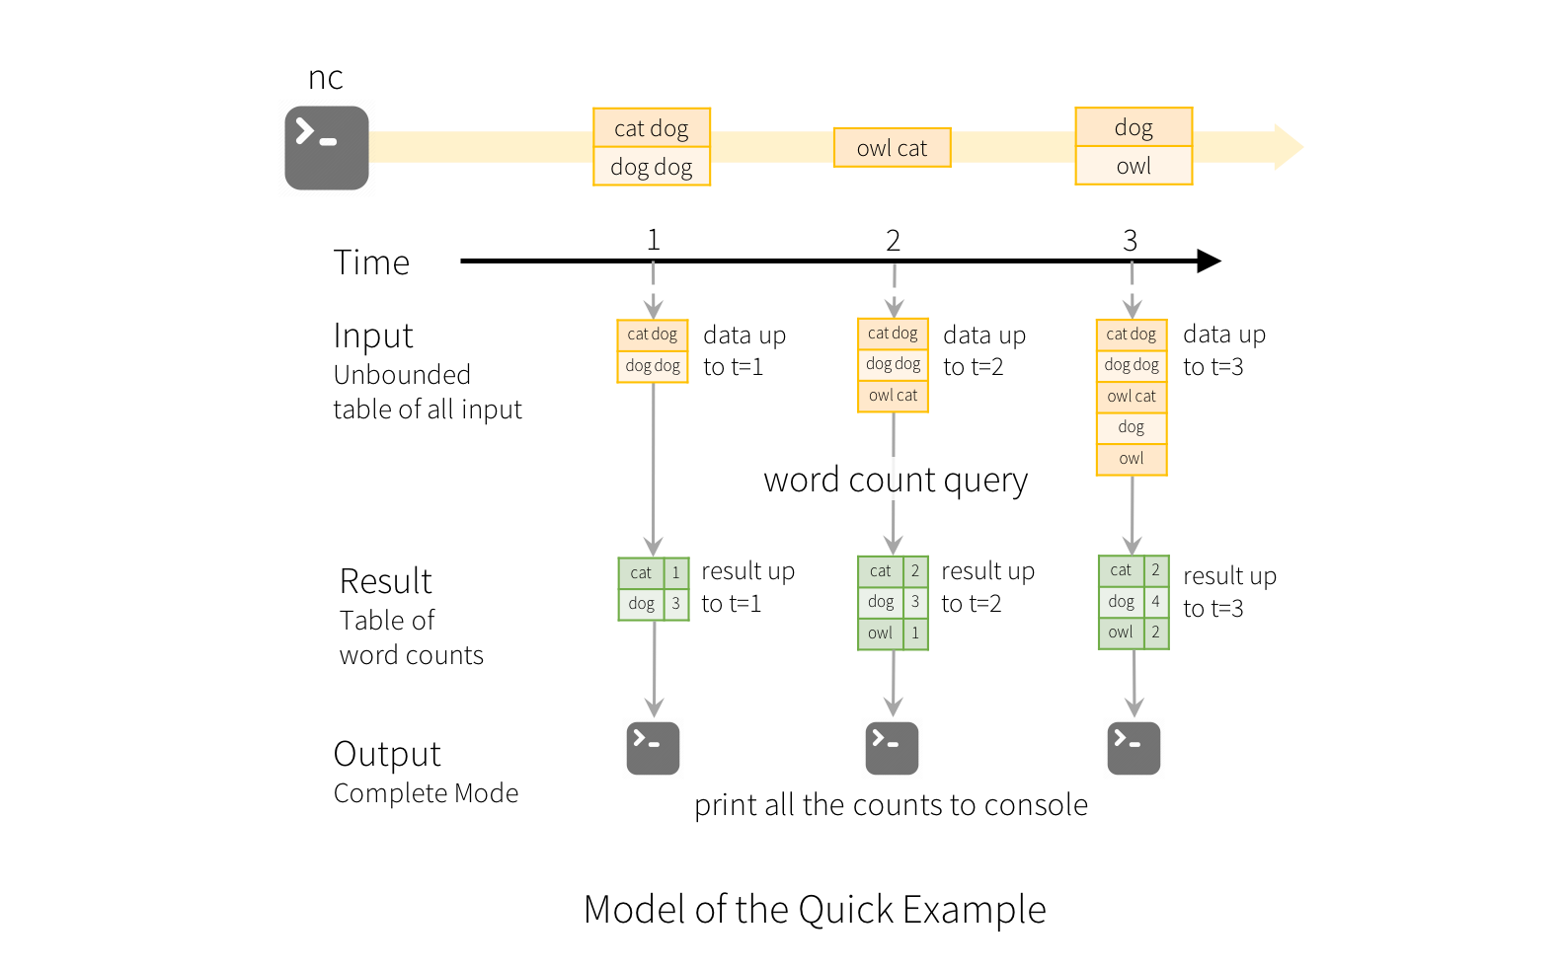

Slide 28
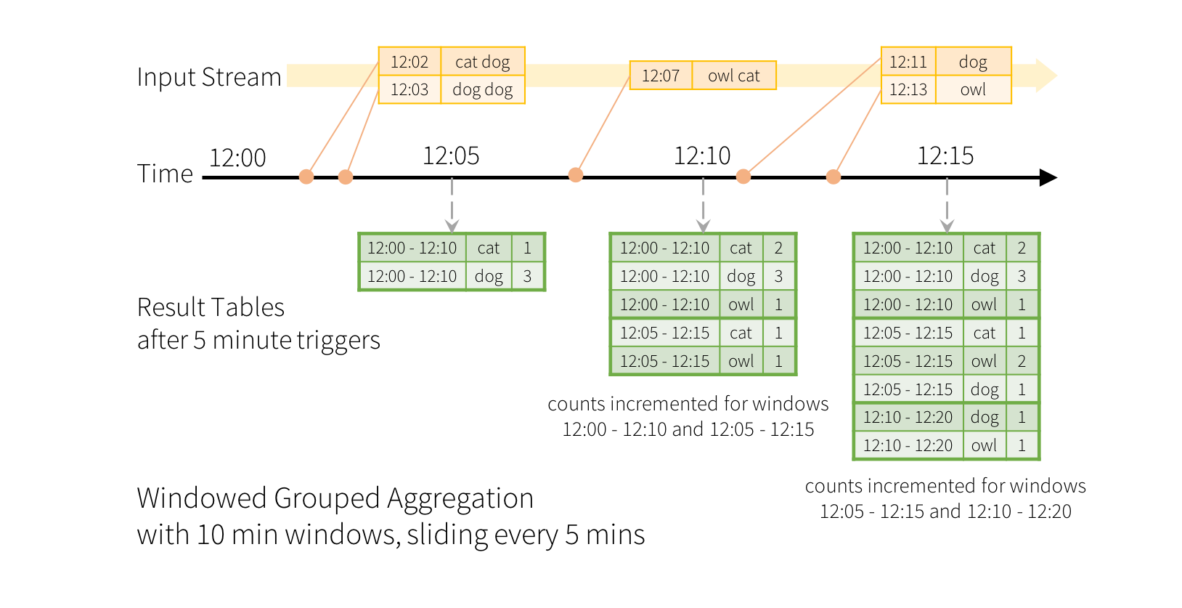
Window Operations on Event Time
windowedCounts = words.groupBy(
window(words.timestamp, "10 minutes", "5 minutes"),
words.word)
.count()

